Slide 1
RFM Customer Segmentation & Cohort Analysis Project
1-SDA 1054-Aeshah Mater
2-SDA1058-Atheer Rashed
3-SDA1043-Afnan
4-SDA1042-Rahaf Saeed
5-SDA1055-Marwah
6-SDA1046-Sarah Moshabab
7-SDA1047-Husam Alzain
8-SDA1048-Salma Mohammed
9-SDA1087-Waad

Slide 2
Introduction
Understanding and effectively managing customer relationships is crucial for sustained success.
One powerful approach to achieve this is through RFM (Recency, Frequency, Monetary) customer segmentation and cohort analysis.
This strategic methodology allows businesses to gain deep insights into customer behavior, preferences, and engagement patterns, ultimately enabling targeted marketing strategies and personalized customer experiences.

Slide 3
Content Overview
01
Problem definition & Objectives
02
03
Project Construction
Conclusion
Data Exploration
04

Slide 4
01
Problem Definition & Objectives

Slide 5
Customer Behavior Understanding: Problem: Understanding how customers behave on the online retail platform.
Product Performance:
Problem: Segregating customers into meaningful segments for targeted marketing.
Sales Trends and Seasonality:
Problem: Understanding sales trends over time and identifying seasonal patterns.

Slide 6
02
Data Exploration

Slide 7
Data Exploration
The Online Retail dataset from the UCI Machine Learning Repository was used for this project.
It includes transactions made between 01/12/2010 and 09/12/2011 for a UK-based and registered non-store online retail.
The dataset has 9 features, such as Invoice Number, Product Code, Product Name, Invoice Date, and Customer Number.
In this project, we will apply RFM, customer segmentation using clustering algorithms, and conduct cohort analysis. Additionally, we will perform data cleaning, data visualization, and exploratory data analysis.

Slide 8
03
Project Construction

Slide 9
Project Construction
RFM Analysis
Data Cleaning & Exploratory Data Analysis
Create Cohort and Conduct Cohort Analysis
Clustering
01
02
03
04

Slide 10
Data Cleaning & Exploratory Data Analysis
1-
Take a look at relationships between InvoiceNo, Quantity and UnitPrice columns.
Clean the Data from the Noise and Missing Values
Explore Customers by Country & Explore the UK Market

Slide 11
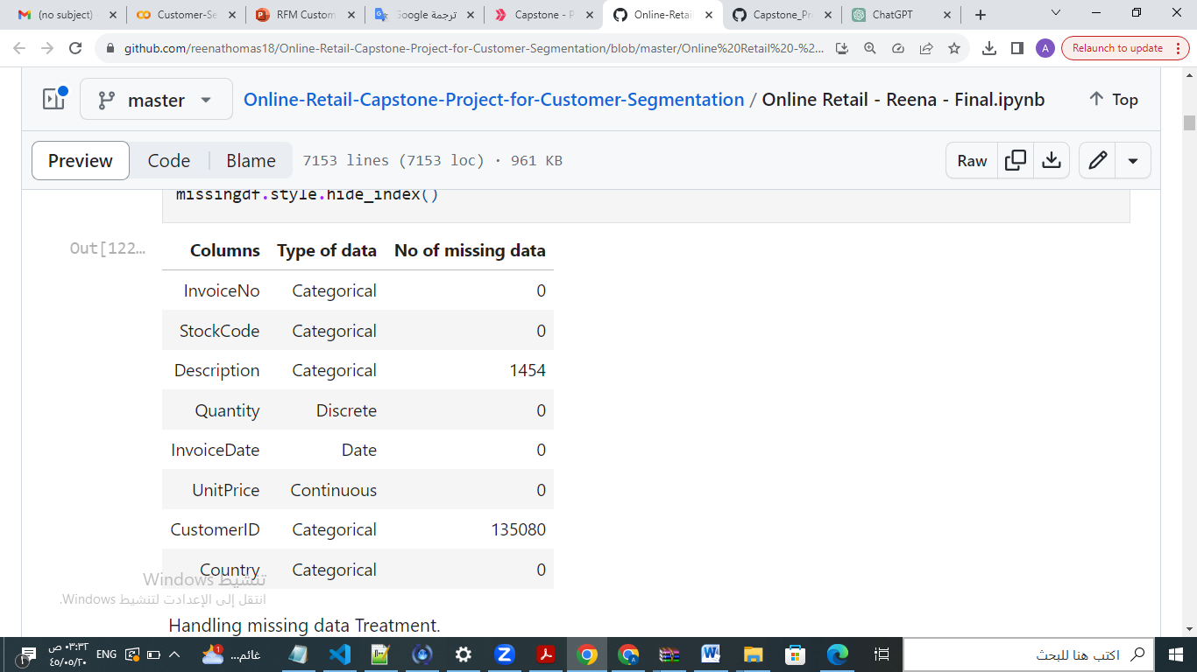
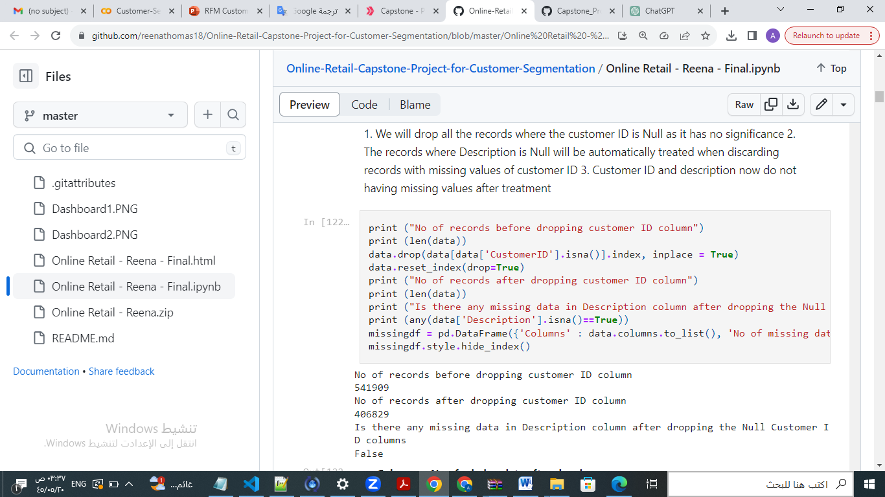
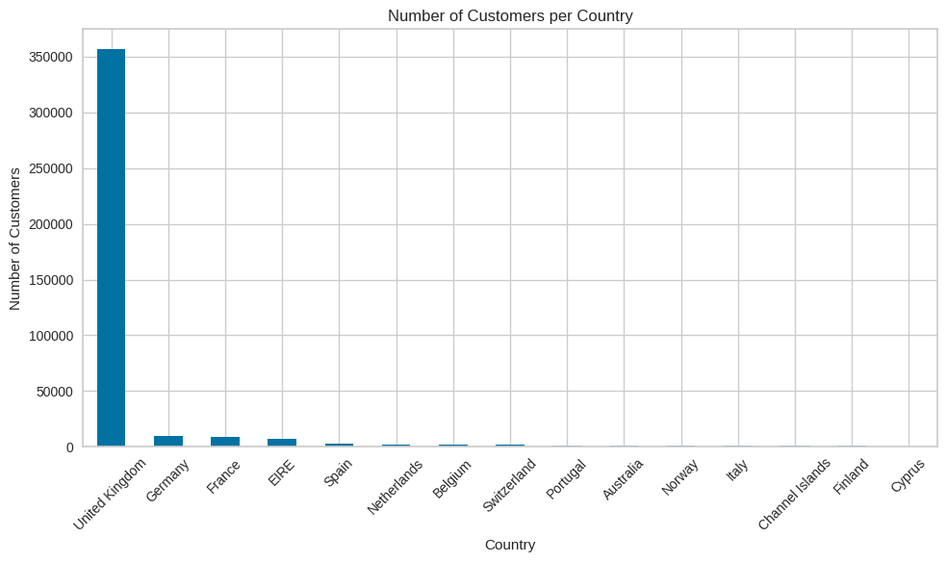
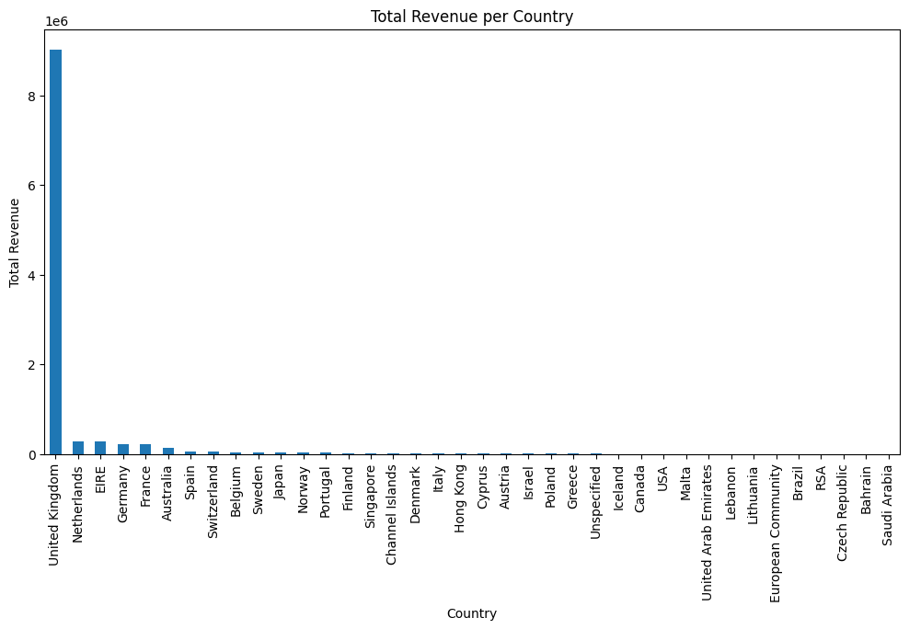
Visualize number of Customer & Total Revenue
per country
Handling Missing Values

Slide 12
RFM Analysis
2-
RFM analysis is a customer segmentation technique in which businesses can analyze their customers based on their past behaviors and habits.
RFM analysis uses three key factors to analyze customer behavior, they are:
Recency: How much time has elapsed since a customer’s last activity or transaction with the brand?
Frequency: How often has a customer transacted or interacted with the brand during a particular period of time?
Monetary: this factor reflects how much a customer has spent with the brand during a particular period of time.

Slide 13
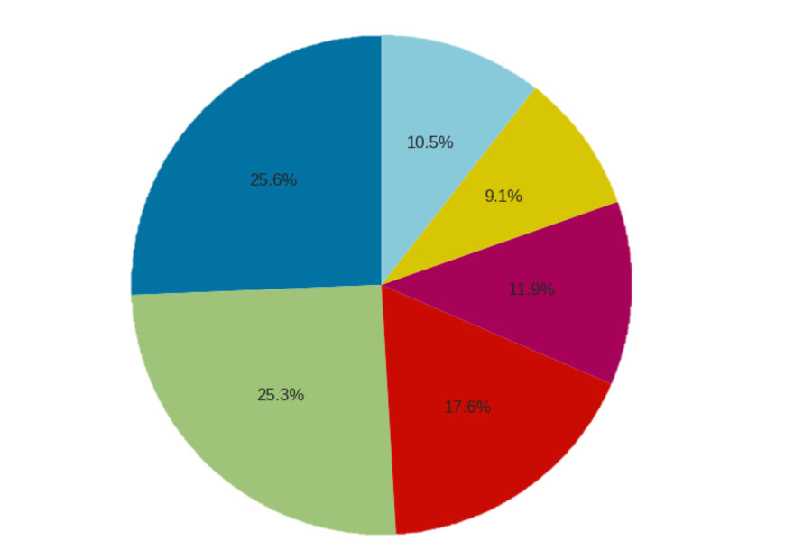
RFM Analysis
2-
RFM Analysis Results
Segment 1 includes 10.5% of the top customers who make frequent purchases.
Segment 2 represents 17.6% of the loyal customers who have been consistently purchasing from the business.
Segment 3 represents 9.1% of the high-spending customers who have a tendency to buy expensive products.
Segment 4 includes 11.9% of the customers who are at the verge of leaving the purchases.
Segment 5 includes 25.3% of the customers who have already left the purchases.
Segment 6 includes 25.6% of the customers who were low-spenders and had left the purchases.

Slide 14
Clustering
3-
Clustering is the task of dividing the unlabeled data or data points into different clusters such that similar data points fall in the same cluster than those which differ from the others.
In simple words, the aim of the clustering process is to segregate groups with similar traits and assign them into clusters.
K-Means Clustering is an iterative clustering algorithm that aims to find local maxima in each iteration.

Slide 15
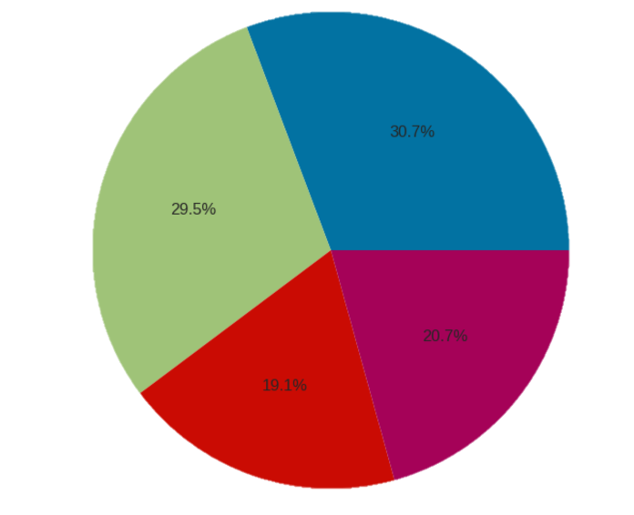
Clustering
3-
K-Means Clustering Results
When apply clustering , one important parameter is the number of clusters (K) to be formed. Based on the data, the optimal number of clusters is found to be 4.
•Cluster 1 represents 19.1% of normal customers.
•Cluster 2 represents 20.7% of best customers.
•Cluster 3 represents 29.5% of almost lost customers.
•Cluster 4 represents 30.7% of lost customers.

Slide 16
Cohort and Conduct Cohort Analysis
4-
Cohort analysis is a type of behavioral analytics in which you take a group of users, and analyze their usage patterns based on their shared traits to better track and understand their actions.
A cohort is simply a group of people with shared characteristics.
.
1- Calculate retention rate Customer retention is a very useful metric to understand how many of all the customers are still active. It gives the percentage of active customers compared to the total number of customers

Slide 17
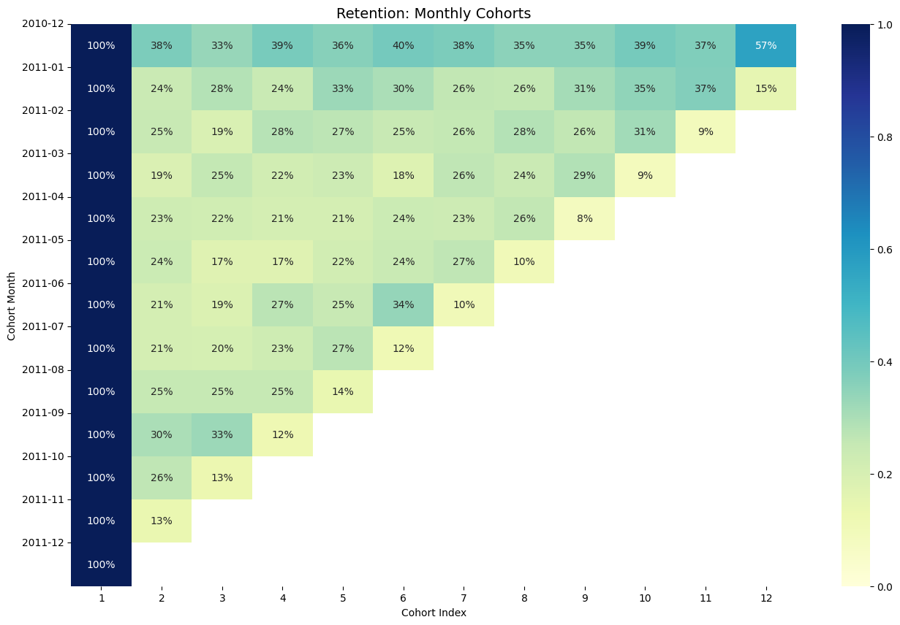
-

Slide 18
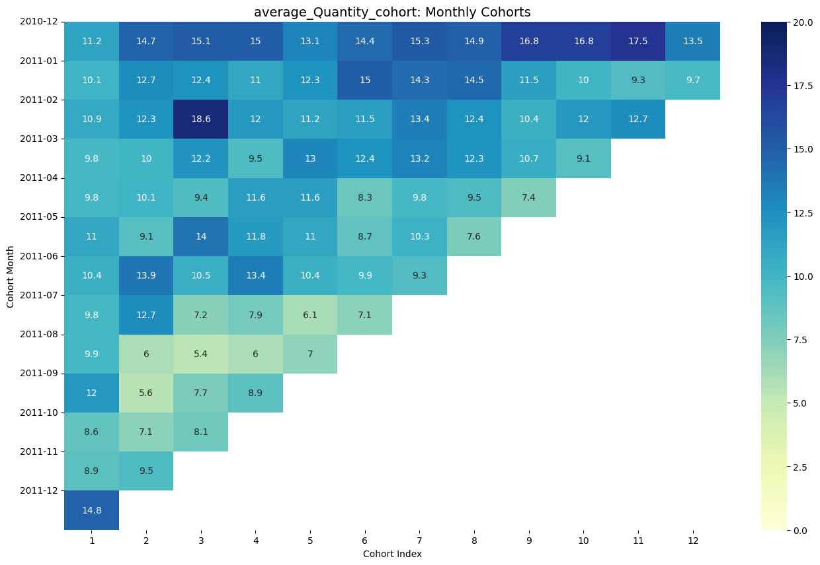

Slide 19
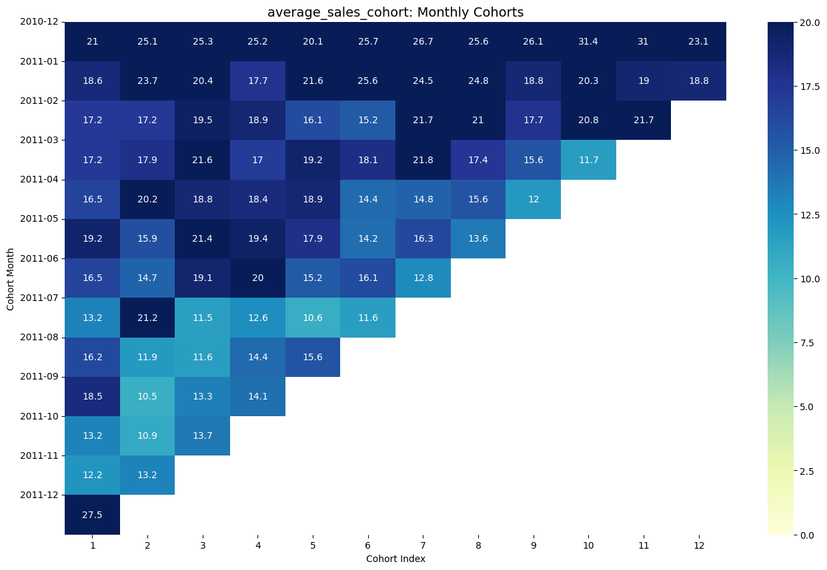

Slide 20
Here are some questions at the end of the note and here are some answers:
Should we focus more on retention rather than acquiring new customers? We believe that it is necessary to focus more on retaining customers because it is evident that existing customers do not come back as well, instead of attracting new customers to create a loyal customer base for this brand.
2) is there a seasoanlity pattern in Customer behahiour?
Yes, there seems to be a seasonality pattern in customer behavior. We observe an increase in sales and returning customers in the month of December. This could be attributed to occasions such as Christmas and others that are significant for the mentioned countries.

Slide 21
04
Conclusion

Slide 22
In conclusion, the notebook provides an end-to-end analysis of customer segmentation, RFM analysis, clustering, and cohort analysis . The insights gained from these analyses can help the company or customer to develop targeted marketing strategies, improve customer retention, and optimize sales performance.

Slide 23
Recommendations for the company:
Targeted Marketing : Utilize RFM analysis to create personalized marketing campaigns for different customer segments. Customize promotions, discounts, and product recommendations based on customers' buying habits.
Customer Retention Focus: Concentrate on retaining valuable customer segments, such as "Big Spenders" or those with high recency and frequency scores. Introduce loyalty programs, personalized offers, or exclusive benefits to encourage repeat purchases.
Enhance Customer Satisfaction: Review customer feedback to identify areas for improvement in product quality, customer service, and shipping processes. Improving the overall customer experience can lead to increased loyalty and positive word-of-mouth.

Slide 24
Thanks!
Any Questions ?

